Slide 1

Technology Hackathon
Gen AI Orchestrator for Email and Document Triage/Routing
Team Name : Innovators
(Ashok Nagabandi, Bibaswan Padhy, Jayaprakash Mahankali, Prathap Reddy Chitam)

Slide 2
Human resources slide 2
AGENDA
Problem Statement
Solution Overview
High-level architecture diagram
Tech Stack & Challenges Faced
Innovation, Uniqueness & Future Scope
Live Demo

Slide 3
Problem Statement
Many organizations receive numerous emails daily, and manually sorting and categorizing them can be time-consuming and error-prone.
Automate email classification and data extraction using GEN AI (LLMs), improving efficiency, accuracy and turnaround time. Also, minimizing the gate keeping activities.

Slide 4

Solution Overview
The LLM-MailOps utilizes GEN AI techniques to classify emails effectively.
It extracts content and attachments from various email formats, including DOCX, TXT, PDF, and images, processes the data, and classifies emails according to request types and sub-request types..
This solution is specifically designed to automate the classification of emails within Commercial Lending services, enhancing the management and response to various requests. Ultimately, it improves efficiency, accuracy, and turnaround time..

Slide 5





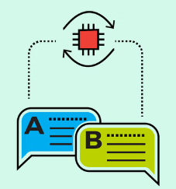



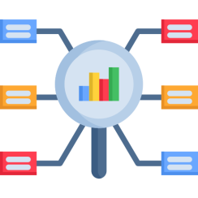



LLM-MailOps High-level architecture diagram
Data Input
Output
Pre-Processing Module
Data Classification Module
Remove duplicates
Prompt Router
LLM
Extract Text
Classifier

Slide 6


Tech Stack & Challenges Faced
Tech Stack
Challenges Faced
Python
PDFPlumber (Extracts PDFs from emails)
PyTesseract (OCR for image attachments)
Open AI (gpt-4o-mini LLM)
JSON (Output)
Flask (API)
Input Dataset preparation and Training Data Limitations
Ambiguity in Email Content
Handling Diverse Email Formats
Fine-Tuning the Model
Subjectivity and Variability in Request Types
Data Privacy and Security Concerns

Slide 7



Innovation, Uniqueness & Future Scope
Innovation
Uniqueness
Future Scope
Seamless Multi-Format Processing.
Scalable and Adaptive Learning System
Duplicate Content Removal
Comprehensive Extraction.
AI-Powered Classification.
Advanced OCR for Image Attachments.
Duplicate Content Removal.
Integration with ServiceNow and CRM Systems to streamline work flows.
Intelligent Email Prioritization & Personalized Email Interaction
Cross-Language Support

Slide 8

Resources
Git Repo : https://github.com/ewfx/gaied-innovators

Slide 9
Demo Video - https://github.com/ewfx/gaied-innovators/blob/main/artifacts/arch/Demo_Innovators.mov

Slide 10

Thank You

